Slide 1




FinTech-ho2020: A Financial supervision and Technology compliance programme
FinTech Risk Management: Credit Risk in P2P Systems
Dr. Branka Hadji Misheva
Scientific Employee @ZHAW

Slide 2





The RESEARCH
BIG DATA ANALYTICS
P2P lending; Credit and systemic risk
BLOCKCHAIN
ARTIFICIAL INTELLIGENCE
ICO and crypto-assets; Fraud detection, money laundering and operational risk
Robo-advice; Compliance and market risk

Slide 3

FinTech and LENDING
Financial Stability Board: FinTech Credit → “All credit activity facilitated by platforms that match borrowers with lenders”
P2P lending - practice of lending money to individuals or businesses through online services;
Lenders and borrowers to match themselves;
The platform provides ratings;
Micro-financing without traditional financial intermediary.

Slide 4
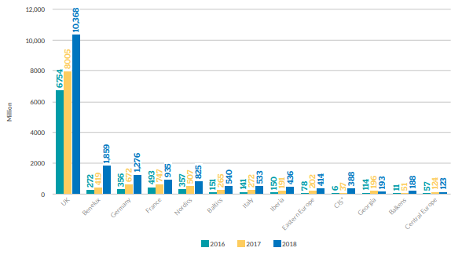
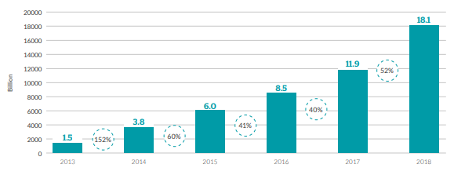
FinTech CREDIT
Figure 1. European Online Alternative Finance Market Volumes 2013-2018 in €billions (Including the UK)
Figure 2. Regional Online Alternative Finance Market Volumes 2016-2018 (€milions)
Source: CCAF, 2020

Slide 5








FinTech and CREDIT RISK
Deposit
Loan
Score
Fee
Figure 3: Difference is risk ownership (Banking vs P2P Platforms)

Slide 6
FinTech-ho2020 – USE CASES
Objective of research efforts:
Identify fintech risk management tools that can improve credit risk estimation in the context of P2P lending platforms
4 use cases selected and disseminated through training and coding sessions;
Network-based credit scoring → we investigate whether network information can improve loan default predictions
Multi-layer perspective:
Financial transactions
Economic similarity
Common ownership and governance

Slide 7
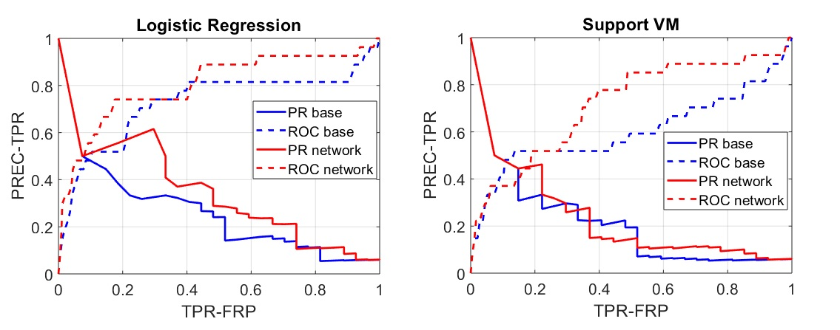

Use Case 1
We propose to exploit the topological information embedded into similarity networks generated by P2P participants
Motivation:
Incentives to push volumes even at the expense of credit standard
Less data
Yet:
ability to use alternative data
flexibility to use novel methodologies
The result suggest that credit risk modeling using topological information or network-based segmentation achieves higher predictive performance than the conventional model.
Figure 4. Precision Recall (PR) and Receiver Operating Characteristic (ROC) curves for the baseline credit risk models and for the network-augmented models. In each panel, dotted lines represent the ROC curves while solid lines refer to PR curves. In blue, we show the results related to the baseline models while in red we show the results related to the network-augmented models.
Use Case 2
The approach first constructs a network of SMEs where links emerge from the co-movement of the latent factors that drive the observed data on individual/firm financial characteristics.
Table 1. Comparing model performance of the prediction of the probability of default from the conventional single credit score model (Single-CSM) and the network-based segmented credit score models (Net-Seg-CSM) for threshold values of “ = {0.01, 0.05, 0.1}.

Slide 8
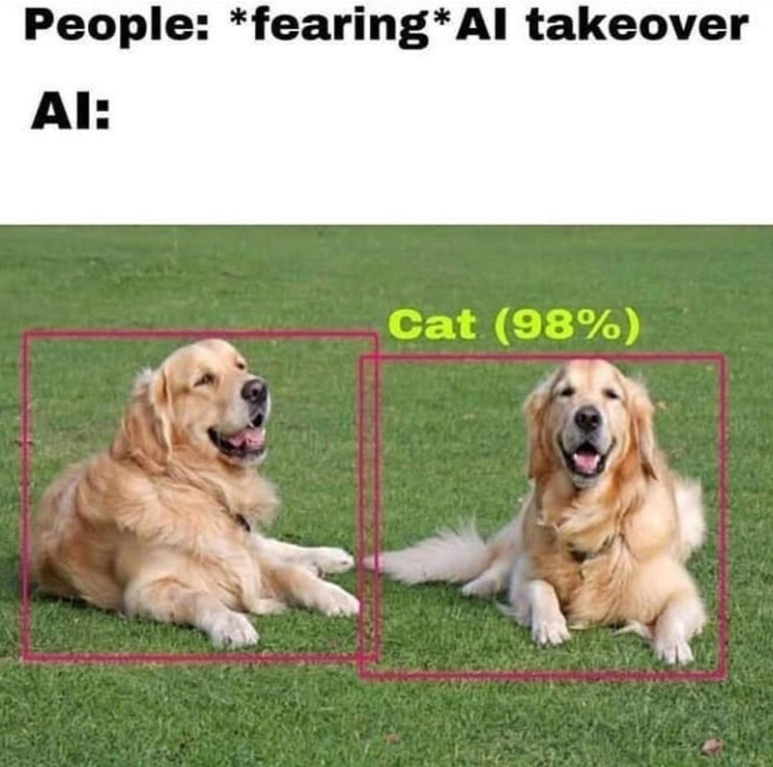




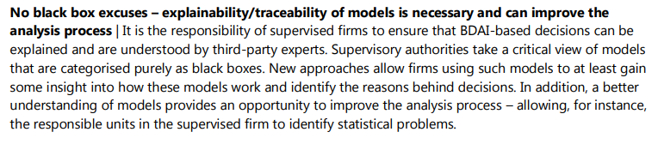
Use Cases: EXTENSIONS
Well …
Where is the progress?
Volumes of
data
Quantitative
Problems
Explainability is the name of the game!
Lending

Slide 9
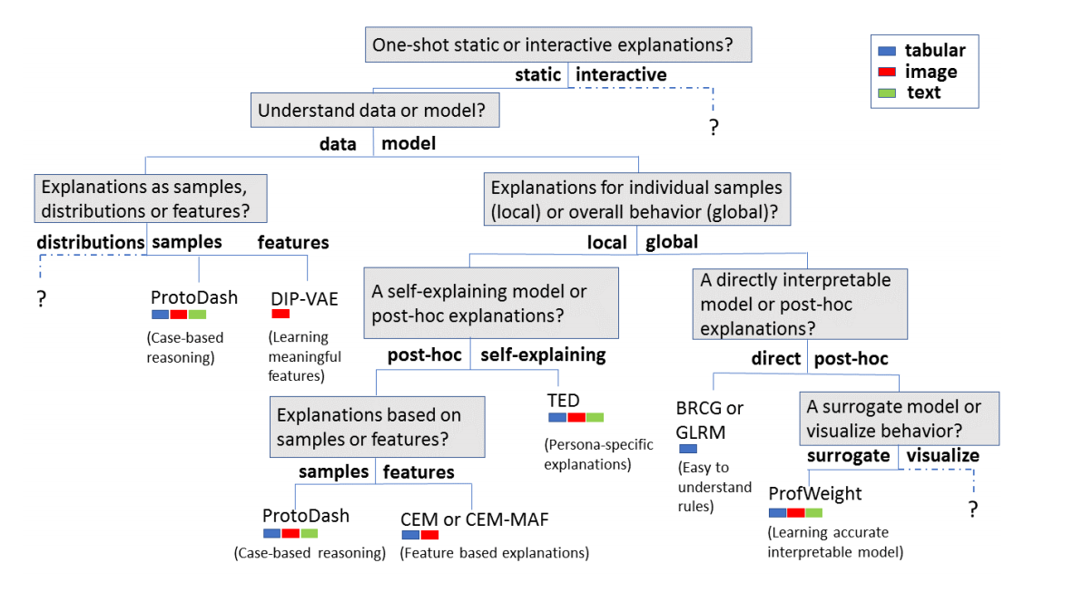
Wider adoption of AI-systems in finance
What is the best way to bring those explanations to different stakeholders in the financial world?
Performance of XAI methods in view of the unique features of financial data
Match explainability needs of stakeholders with the XAI methods
XAI Research
XAI research in FINANCE
Deployment
Productivity
Source: Arya et al. (2019) One Explanation Does Not Fit All

Slide 10

Thank you for your attention!

